Slide 2
The Joy Of Forgiveness and Our Responsibility Towards It
Psalm 32:1-11

Slide 3
The Background
David repenting and asking forgiveness for sins against Bathsheba and Uriah
Psalm teaches a timeless truth:
  2 Samuel 11:1-5, 14-17,26,27
Two Alternatives Concerning Sin – Romans 3:23
  We can shut them up within ourselves, become bitter, and rot on the inside
  We can confess them to God, receive forgiveness, and rejoice in the fact
  1 John 1:8,9 “He is faithful and just to forgive us our sins and to cleanse us from all unrighteousness.”

Slide 4
PSALM 32 EXAMINED
Blessed Forgiveness
  Verses 1,2
  Transgression – rebellion against God’s authority
  Sin – missing of the mark
  Iniquity – moral twisting or distortion, crookedness
ALL SIN
  Exodus 20:13,14 – Rebelled against God’s authority
  He missed the Target!
  Twisted out of shape God’s Law and his relation to it

Slide 5
PSALM 32 EXAMINED
Verses 3,4
  Kept Silence – refusal to confess his sins
  Thinking he could hide it, decided to ignore it!
  His sensitive heart would give him no peace!
  Produced agony which he described as bones wasting away
ALL who have sinned, refuse to repent
  Proverbs 28:13 “whoever confesses and forsakes them will have mercy.”
  Acts 8:22; 1 John 1:9; Revelation 2:5

Slide 6
PSALM 32 EXAMINED
Verse 5 “sin...iniquity…transgressions”
  He stopped trying to hide his sins from God
  Primarily he had sinned against GOD – Psalm 51:4
  Only God can forgive sin
Verse 6 “godly shall pray to You”
  Acts 17:27 “He is not far from each one of us.”
  God always available to those who seek Him- Deuteronomy 4:29
  David knew the JOY of being pardoned, and wanted others to know it also

Slide 7
PSALM 32 EXAMINED
Prayer And Counsel
  Verse 7 “You are my hiding place”
  The Lord is protector & comforter of His followers
  Songs Of Deliverance – shout of deliverance
Verse 8 “teach you in the way you should go”
  Psalm 48:14 “our God forever and ever”
  Need the Lord’s help more than ever!
  God watches over us with His eyes!
  We should keep our eyes upon Him!

Slide 8
PSALM 32 EXAMINED
Verse 9 “which have no understanding”
  God still speaking – David warned not to be stubborn
  We should be controlled by OUR WILL being in tune with GOD’S WILL
Shared Knowledge
  David returns to his own words
  Out of his own experience he shared with others that they might know and be able to experience the joy that was in his own heart

Slide 9
PSALM 32 EXAMINED
Verse 10 “mercy shall surround him”
  When I was wrong, I was troubled and had no place to turn
  When I was right, I had God on my side
Other places this thought expressed:
  Job 15:20 “wicked man writhes with pain”
  Proverbs 13:15 “the way of the unfaithful is hard”
  Romans 2:9-11 “no partiality with God”
  Romans 3:16 “Destruction & misery in their ways”

Slide 10
PSALM 32 EXAMINED
Verse 11 “shout for joy”
  Asks all righteous ones to rejoice with him
  Only after he had bared his soul before God in confession and cried for forgiveness did he know the JOYS of one who sins are FORGIVEN!
  The Bible never promises sinless perfection for the Christian in this life
  So when we DO SIN, we should not seek to hide it from the Lord – waste of time!
  ONLY through REPENTANCE, CONFESSION and FAITH can we be forgiven

Slide 11
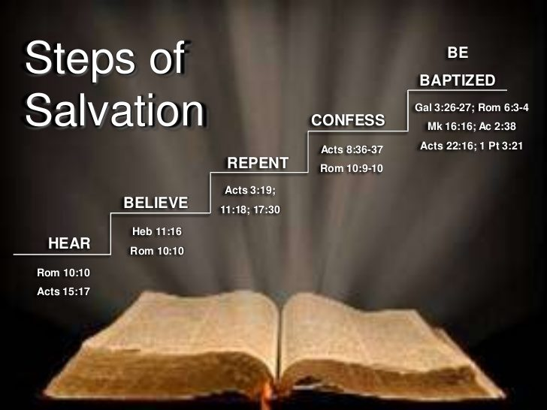

Slide 12
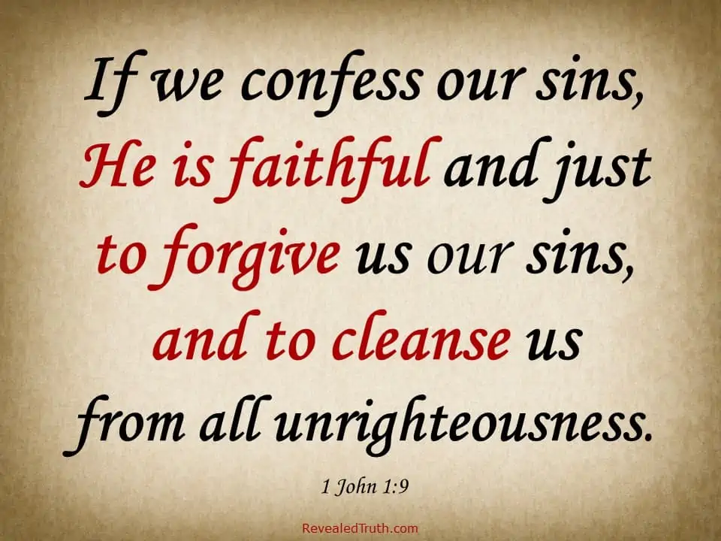

Slide 13
